Slide 1
Jess관련 과제 (재정상담시스템/MEDIA ADVISOR)

Slide 2
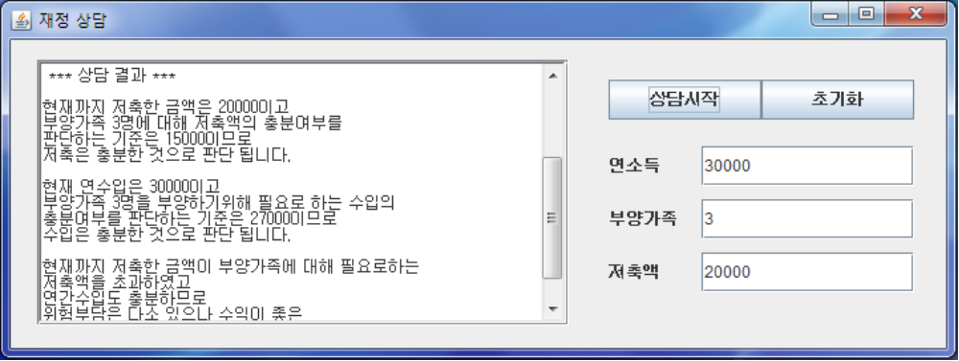
재정상담시스템
재정상담시스템의 구현

Slide 3
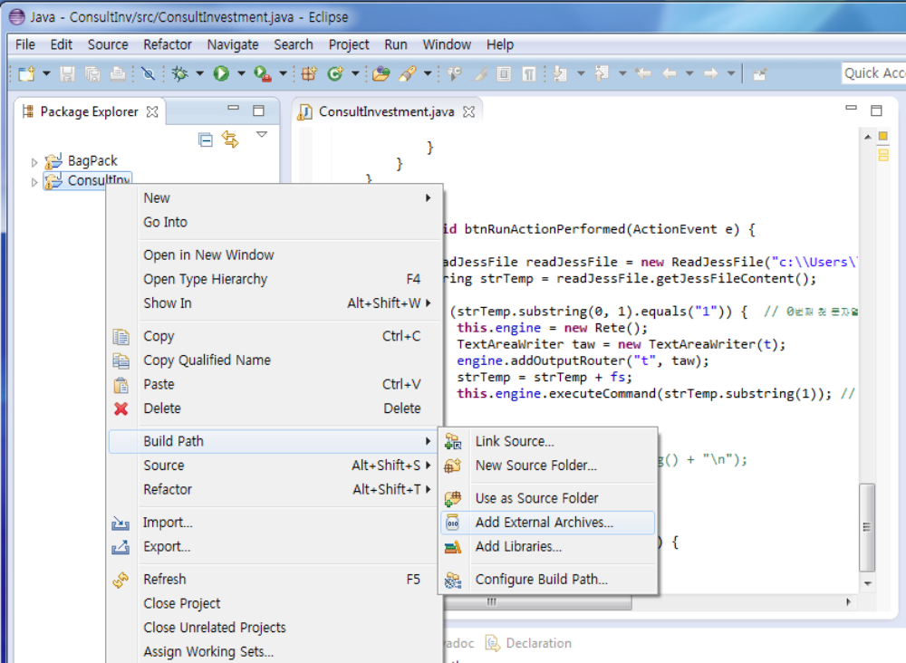
eclipse 사용자의 Jess 실행환경 구축
  Build Path -> Add External Archives… -> Jess71p2/lib/jess.jar 선택

Slide 4
Java 프로그램에 대한 설명
import javax.swing.*;
import java.awt.event.*;
import java.awt.*;
import java.util.*;
import jess.*;
import jess.awt.TextAreaWriter;
public class InvCon extends JFrame {
TextArea t;
JButton b1, b2 ;
JTextField tf1, tf2, tf3 ;
JLabel jl1, jl2, jl3 ;
String fs;
Rete engine ;
InvCon() {
setTitle("재정 상담");
setLayout(null);
setDefaultCloseOperation(JFrame.EXIT_ON_CLOSE);

Slide 5
t = new TextArea(10, 40);
JScrollPane js = new JScrollPane(t);
js.setSize(400, 200);
js.setLocation(20, 15);
add(js);
MyActionListener ml
= new MyActionListener();
b1 = new JButton("상담시작");
b1.addActionListener(ml);
b1.setSize(180, 30);
b1.setLocation(450, 30);
add(b1);
b2 = new JButton("초기화");
b2.addActionListener(ml);
b2.setSize(180, 30);
b2.setLocation(630, 30);
add(b2);
jl1 = new JLabel("연소득");
tf1 = new JTextField(20);
jl1.setSize(100, 30);
tf1.setSize(260, 30);
jl1.setLocation(450, 80);
tf1.setLocation(550, 80);
add(jl1);
add(tf1);
jl2= new JLabel("부양가족");
tf2 = new JTextField(20);
jl2.setSize(100, 30);
tf2.setSize(260, 30);
jl2.setLocation(450, 120);
tf2.setLocation(550, 120);
add(jl2);
add(tf2);
jl3= new JLabel("저축액");
tf3 = new JTextField(20);
jl3.setSize(100, 30);
tf3.setSize(260, 30);
jl3.setLocation(450, 160);
tf3.setLocation(550, 160);
add(jl3);
add(tf3);
setSize(850,270);
setVisible(true);
}

Slide 6
private class MyActionListener implements ActionListener {
public void actionPerformed(ActionEvent e) {
JButton b = (JButton)e.getSource();
if(b == b1) {
t.append("\n \n *** 상담 의뢰인의 현황 *** \n \n" );
t.append("연수입 : " + "$"+ tf1.getText() + "\n");
t.append("부양가족 : " + tf2.getText() + "명" + "\n");
t.append("저축액 : " + "$" + tf3.getText() + "\n");
fs = "";
fs = fs + "\n(assert (earnings " + tf1.getText() + " steady))";
fs = fs + "\n(assert (dependents " + tf2.getText() + "))";
fs = fs + "\n(assert (amount_saved " + tf3.getText() + "))";
fs = fs + "\n (run)";
t.append("\n \n *** 상담 결과 *** \n \n" );
btnRunActionPerformed(e);
} else if (b == b2){
t.setText(""); tf1.setText(""); tf2.setText("");
tf3.setText(""); fs = "";}
}
}

Slide 7
private void btnRunActionPerformed(ActionEvent e) {
try {
ReadJessFile readJessFile = new
ReadJessFile("c:\\Users\\...\\workspace\\ConsultInv\\bin\\Consult.clp");
String strTemp = readJessFile.getJessFileContent();
if (strTemp.substring(0, 1).equals("1")) { // 0번째 첫 문자열
this.engine = new Rete();
TextAreaWriter taw = new TextAreaWriter(t);
engine.addOutputRouter("t", taw);
strTemp = strTemp + fs;
this.engine.executeCommand(strTemp.substring(1));
// 1번째부터 전체 문자열, 자바에서 Jess 실행
}
} catch (JessException ex) {
// this.taTrace.append(ex.toString() + "\n");
}
}
public static void main(String [] args) {
new InvCon();
}

Slide 8
ReadJessFile
import java.io.BufferedReader;
import java.io.FileInputStream;
import java.io.FileNotFoundException;
import java.io.IOException;
import java.io.InputStreamReader;
import java.io.*;
public class ReadJessFile {
private String strFilePath = null;
public ReadJessFile(String strFilePath)
{
this.strFilePath = strFilePath;
}
public String getJessFileContent()
{
try
{
// 파일로 부터 데이타를 읽어온다(시작)
FileInputStream fis = new FileInputStream(this.strFilePath);
BufferedReader brFileContents = new BufferedReader(new InputStreamReader(fis));
String strFileContent = "";
String strReturnValue = "";

Slide 9
while(true)
{
strFileContent = brFileContents.readLine();
if(strFileContent == "" || strFileContent == null)
{
break;
}
else
{
strReturnValue += strFileContent + "\n";
}
}
return "1" + strReturnValue.trim();
}
catch(FileNotFoundException fnfe)
{
return "0" + "지정한 파일을 찾을수가 없습니다!!!";
}
catch(IOException ioe)
{
return "0" + "파일을 읽는 과정에서 에러가 발생하였습니다!!!";
}
}
}

Slide 10
재정 상담 시스템을 위한 함수와 규칙의 예
(deffunction incomead (?x, ?y)
(printout t "현재 연수입은 " ?x "이고" crlf)
(printout t "부양가족 " ?y "명을 부양하기위해 필요로 하는 수입의" crlf)
(printout t "충분여부를 판단하는 기준은 " (+ 15000 (* 4000 ?y))
"이므로" crlf)
(printout t "수입은 충분한 것으로 판단 됩니다." crlf crlf))
(defrule R6
(earnings ?x steady)
(dependents ?y&: (>= ?x (+ 15000 (* 4000 ?y))))
=>
(incomead ?x ?y)
(assert (income adequate)))

Slide 11
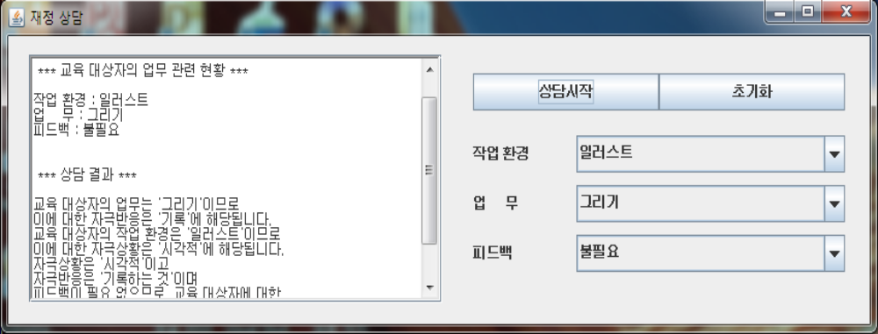
MEDIA ADVISOR
Media Advisor의 구현 (교재 p68)

Slide 12
import javax.swing.*;
import java.awt.event.*;
import java.awt.*;
import java.util.*;
import jess.*;
import jess.awt.TextAreaWriter;
public class MediaAdvisor extends JFrame {
TextArea t;
JButton b1, b2 ;
JComboBox jc1, jc2, jc3 ;
JLabel jl1, jl2, jl3 ;
String [] env = { "논문", "매뉴얼", "문서", "참고서", "그림", "일러스트", "사진", "도표",
"기계", "건물", "도구", "숫자", "수식", "컴퓨터프로그램"} ;
String [] work = {"강의", "조언", "상담", "만들기", "수리하기", "조정하기","쓰기", "타이핑하기",
"그리기", "평가하기", "추론하기", "조사하기"};
String [] fb = {"필요", "불필요"};
String fs;
Rete engine ;

Slide 13
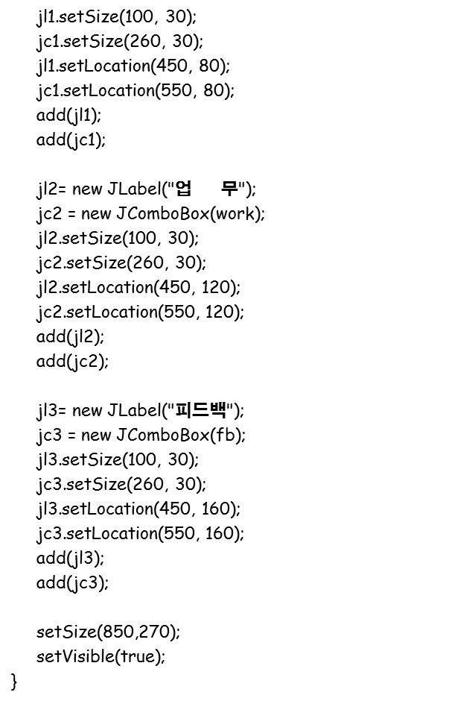
MediaAdvisor() {
setTitle(“Media Advisor");
setLayout(null);
setDefaultCloseOperation(JFrame.EXIT_ON_CLOSE);
t = new TextArea(10, 40);
JScrollPane js = new JScrollPane(t);
js.setSize(400, 200);
js.setLocation(20, 15);
add(js);
MyActionListener ml = new MyActionListener ();
b1 = new JButton("상담시작");
b1.addActionListener(ml);
b1.setSize(180, 30);
b1.setLocation(450, 30);
add(b1);
b2 = new JButton("초기화");
b2.addActionListener(ml);
b2.setSize(180, 30);
b2.setLocation(630, 30);
add(b2);
jl1 = new JLabel("작업 환경");
jc1 = new JComboBox(env);

Slide 14
private class MyActionListener implements ActionListener {
public void actionPerformed(ActionEvent e) {
JButton b = (JButton)e.getSource();
if(b == b1) {
t.append("\n \n *** 교육 대상자의 업무 관련 현황 *** \n \n" );
t.append("작업 환경 : " + jc1.getSelectedItem() + "\n");
t.append("업 무 : " + jc2.getSelectedItem() + "\n");
t.append("피드백 : " + jc3.getSelectedItem() + "\n");
fs = "";
fs = fs + "\n(assert (작업환경 " + jc1.getSelectedItem() + "))";
fs = fs + "\n(assert (업무 " + jc2.getSelectedItem() + "))";
fs = fs + "\n(assert (피드백 " + jc3.getSelectedItem() + "))";
fs = fs + "\n (run)";
t.append("\n \n *** 상담 결과 *** \n \n" );
btnRunActionPerformed(e);
} else if (b == b2){
t.setText("");
fs = "";
}
}
}

Slide 15
private void btnRunActionPerformed(ActionEvent e) {
try {
ReadJessFile readJessFile = new
ReadJessFile("c:\\Users\\yjkim\\workspace\\Media\\bin\\Media.clp");
String strTemp = readJessFile.getJessFileContent();
if (strTemp.substring(0, 1).equals("1")) { // 0번째 첫 문자열
this.engine = new Rete();
TextAreaWriter taw = new TextAreaWriter(t);
engine.addOutputRouter("t", taw);
strTemp = strTemp + fs;
this.engine.executeCommand(strTemp.substring(1));
// 1번째부터 전체 문자열, 자바에서 Jess 실행
}
} catch (JessException ex) {
// this.taTrace.append(ex.toString() + "\n");
}
}
public static void main(String [] args) {
new MediaAdvisor();
}
}

Slide 16
(deffunction res01 (?x ?y)
(printout t "교육 대상자의 작업 환경은 '" ?x "'이므로" crlf)
(printout t "이에 대한 자극상황은 '" ?y "'에 해당됩니다." crlf))
(defrule R2
(작업환경 ?x)
(작업환경 그림|일러스트|사진|도표)
=>
(res01 ?x 시각적)
(assert (자극상황 시각적)))

